Slide 1

Basic Electrical Engineering (BEEE101L)
Presented By
Dr. Maddela Chinna Obaiah
Assistant Professor (Sr)
School of Electrical Engineering

Slide 2
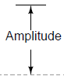
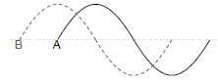
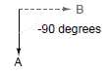
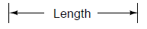
Representation of Sinusoidal
Wave form
Equation
Phasor

Slide 3
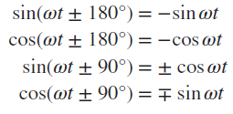
BASIC TRIGONOMETRY
RADIANS AND DEGREES

Slide 4
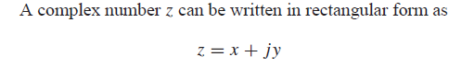
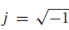
PHASORS
The notion of solving ac circuits using phasors was first introduced by Charles Steinmetz in 1893.
Sinusoids are easily expressed in terms of phasors, which are more convenient to work with than sine and cosine functions.
A phasor is a complex number that represents the amplitude and phase of a sinusoid.

Slide 5
Phasor
For analysis of alternating circuits, a sinusoidal quantity (voltage or current) is represented by a line of definite length rotating in anti-clock wise direction with the same angular velocity as that of the sinusoidal quantity.
This rotating line is called a ‘Phasor’.
However, a sinusoid is specified by its amplitude and phase angle, they are termed as Phasor.
A phasor is a complex number that represents the amplitude and phase of a sinusoid.

Slide 6
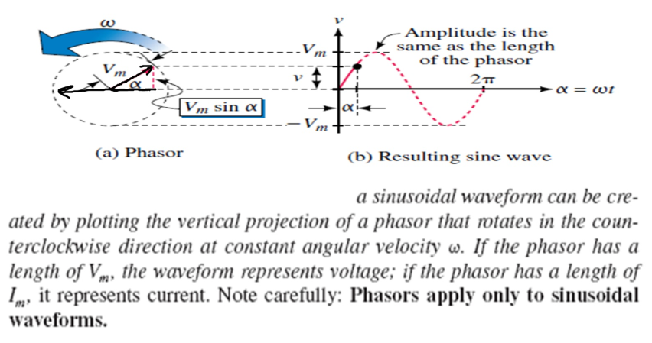

Slide 7
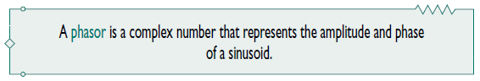
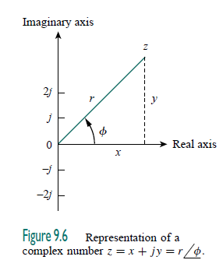
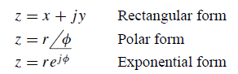
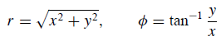
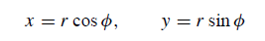
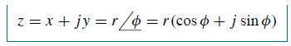
Phasors

Slide 8
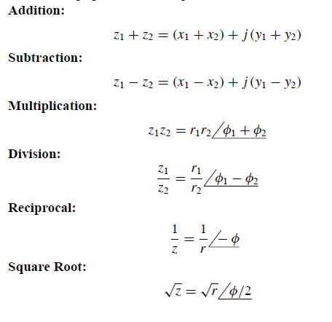

Slide 9
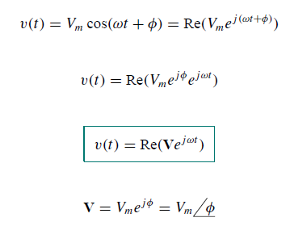
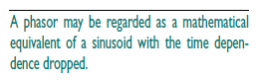
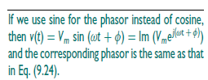
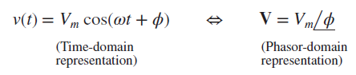
Phasor Transformation

Slide 10
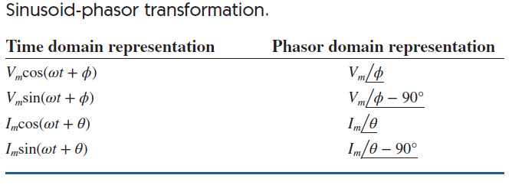
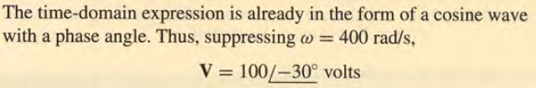
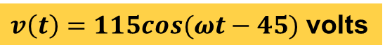
Transform the frequency (phasor) domain voltage $v\left(t\right)=115∠−45°$ volts into the time-domain.
$v\left(t\right)=115cos(ωt−45)$ volts

Slide 11
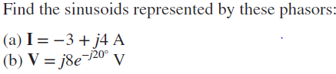
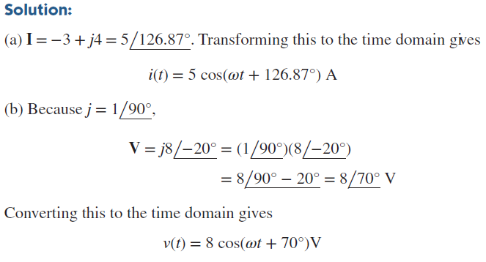

Slide 12
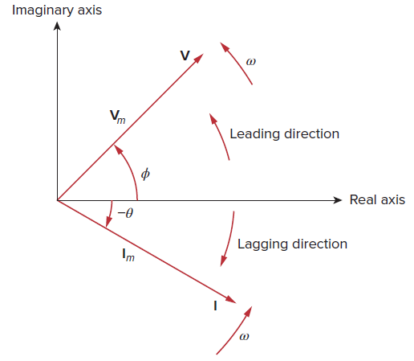
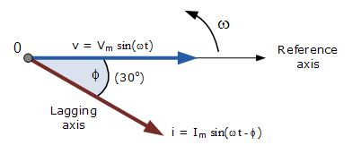
Phasor diagrams
Phasor diagram is a sketch in a complex plane showing the relationship between the phasor voltage and phasor current for a given circuit.

